Slide 1




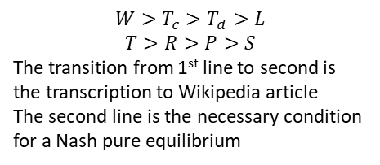






$$W>T_{c}>T_{d}>L$$
$$T>R>P>S$$
The transition from 1st line to second is the transcription to Wikipedia article
The second line is the necessary condition for a Nash pure equilibrium
$$T_{c}=1$$
$$W=4$$
no PED
$$T_{c}=1$$
$$L=−4$$
$$L=−4$$
$$T_{d}=−1$$
PED
$$W=4$$
$$T_{d}=−1$$
no PED
PED

Slide 2

23-20

